Slide 1

Frequent problems in ML
DATA ANALYTICS | IRONHACK

Slide 2

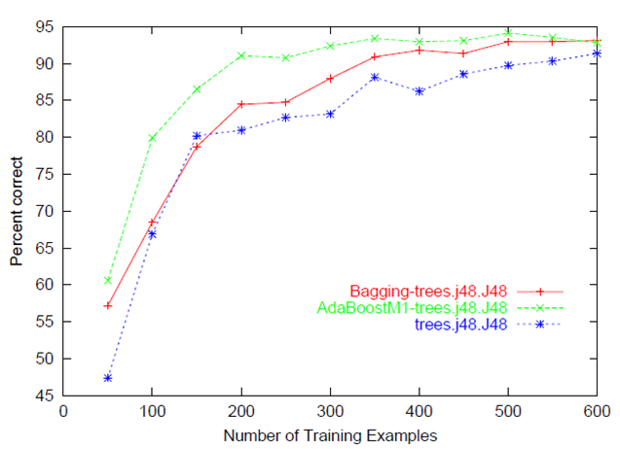
IRONHACK BOOTCAMP
INSUFFICIENT DATA
How much data is enough?
Learning curves answer this question. They plot how an error metrics improves with the dataset size.
At some point, the performance of the model will stabilize showing that the dataset size is big enough.
Even so, you may have error (bias) because of lack of relevant data in your dataset.

Slide 3
IRONHACK BOOTCAMP
HARDWARE LIMITATIONS
Can your computer train a model with 1,000,000 observations and 25 features? Try it! (save everything important first)
Consider cloud computing

Slide 4
IRONHACK BOOTCAMP
THE CURSE OF DIMENSIONALITY (I)
We want as much information as possible for our algorithms to find patterns, but more attributes mean:
More training time
Difficult interpretation
Possibly worse performance
Problem common in:
Computer vision (each pixel is a data point)
NLP (each word + each pair of words + each triplet of words +

Slide 5
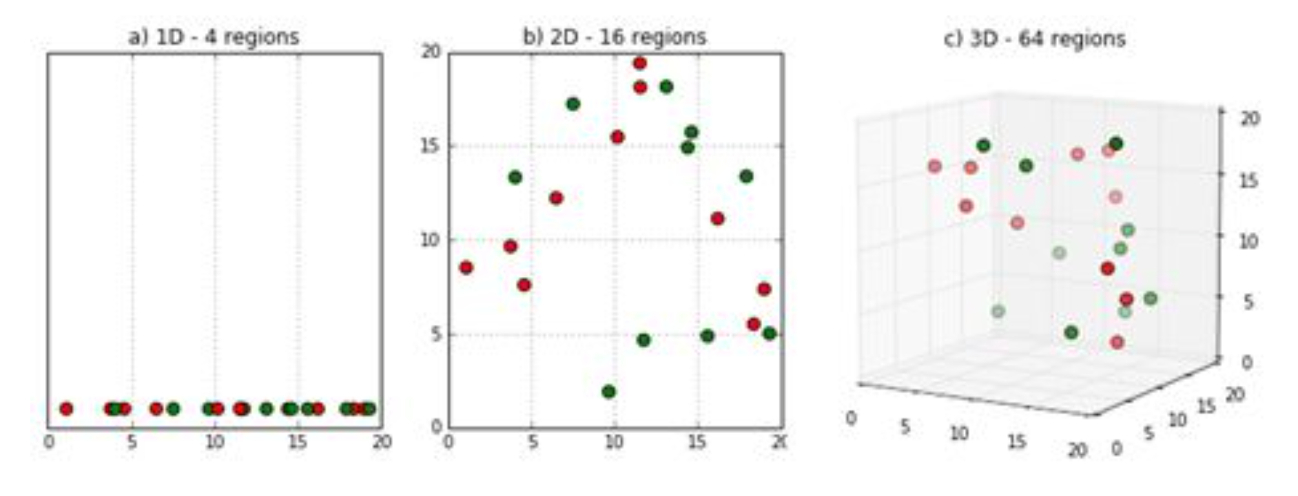
IRONHACK BOOTCAMP
THE CURSE OF DIMENSIONALITY (II)
Problem common in:
Computer vision (each pixel is a data point)
NLP (each word + each pair of words + each triplet of words + ..
High dimensionality = lower density
With more “regions” and the same number of observations, we have fewer observations per region

Slide 6
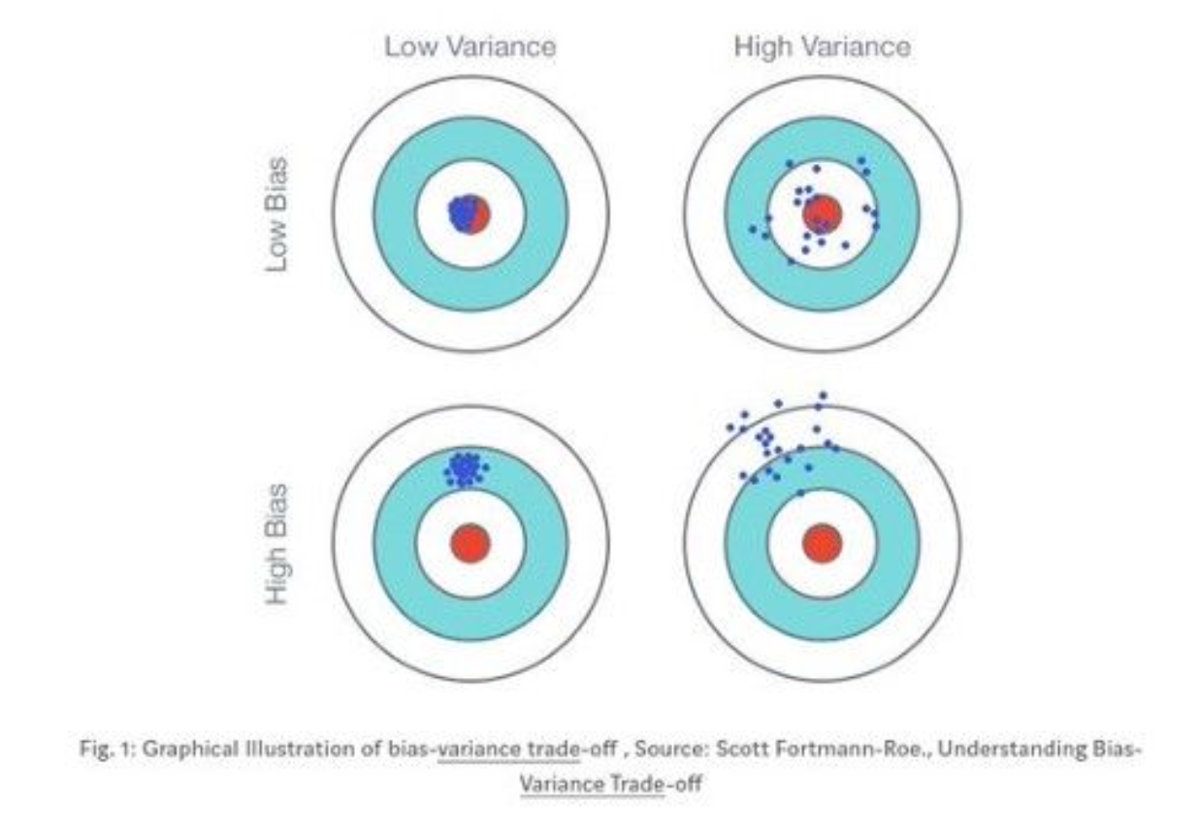
IRONHACK BOOTCAMP
BIAS VS VARIANCE TRADEOFF
Bias: the difference between the average prediction and the real value.
Variance: how much variability it has our model predictions.
Having both small is not possible, we need to find a tradeoff.

Slide 7
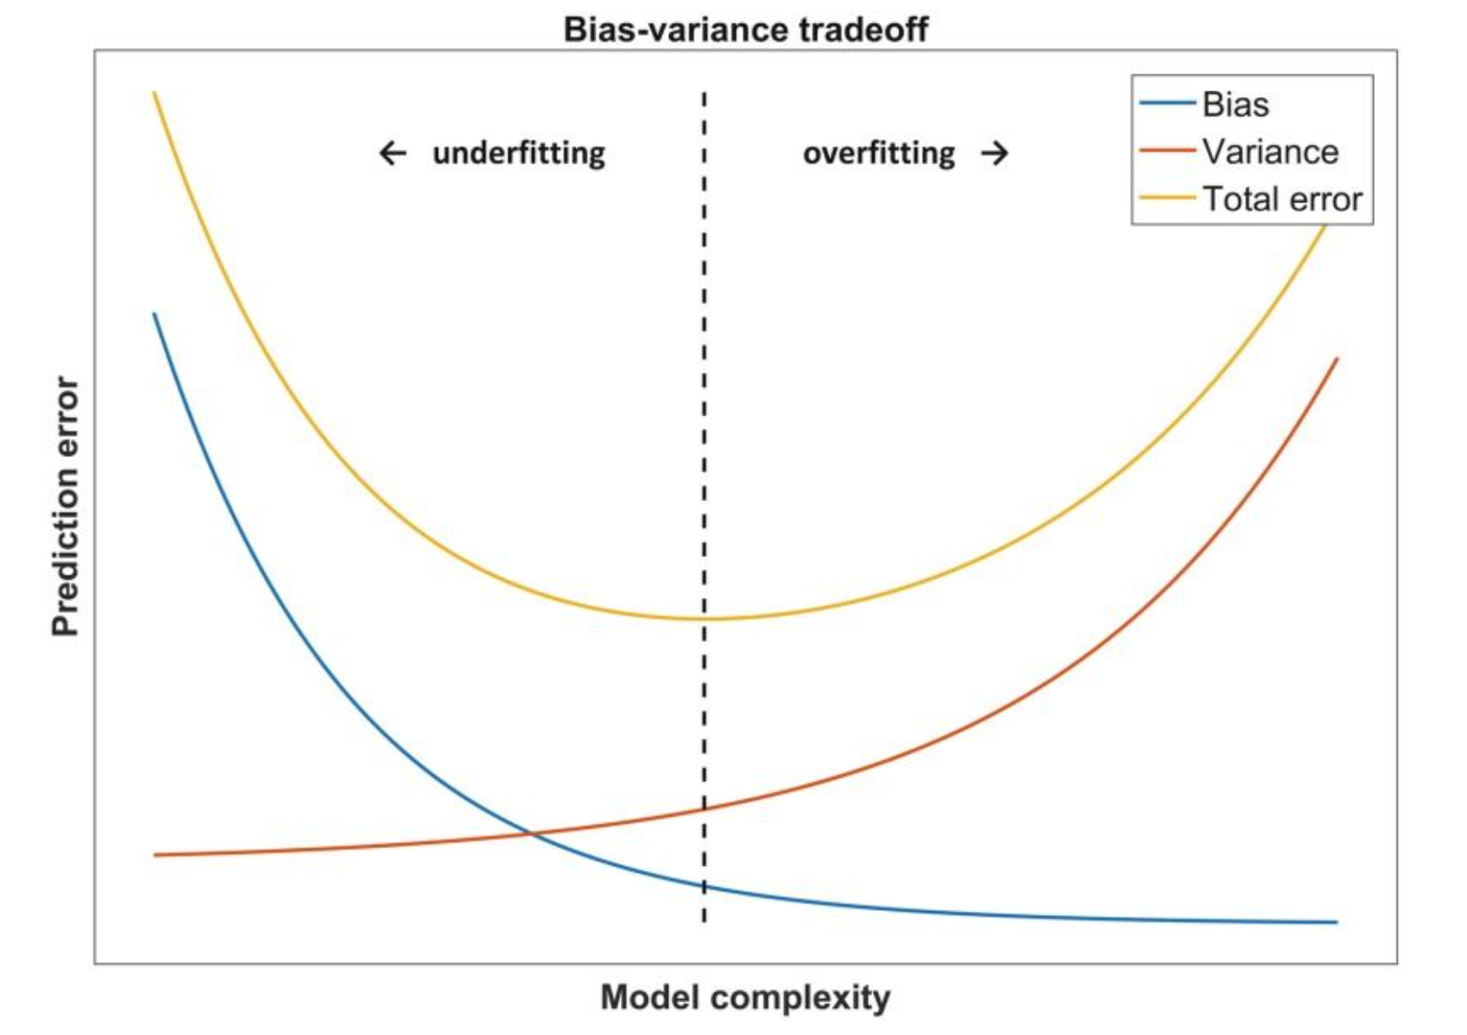
IRONHACK BOOTCAMP
BIAS VS VARIANCE TRADEOFF

Slide 8


